Slide 1
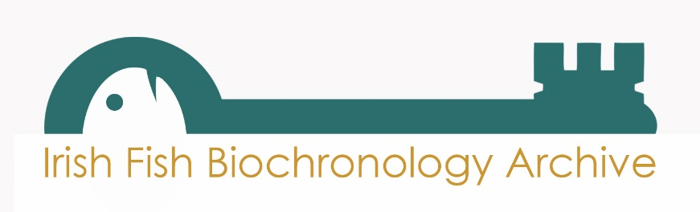
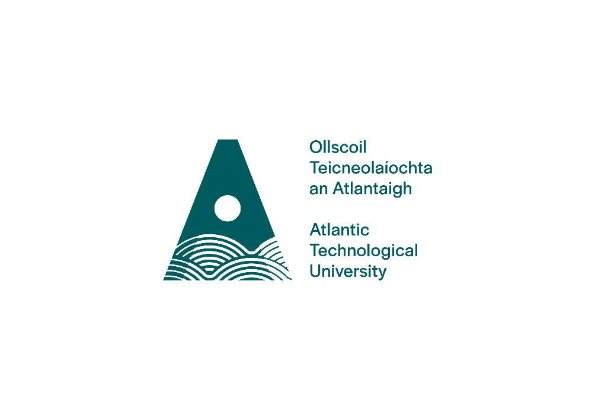
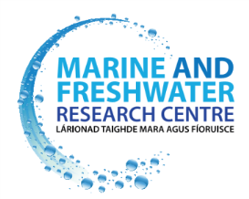

Unlocking the archive
Developing The Irish Fish Biochronology Archive
Deirdre Brophy, Marine and Freshwater Research Centre, ATU

Slide 2
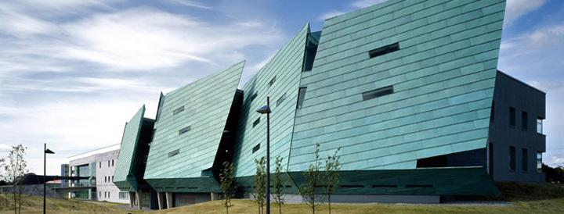
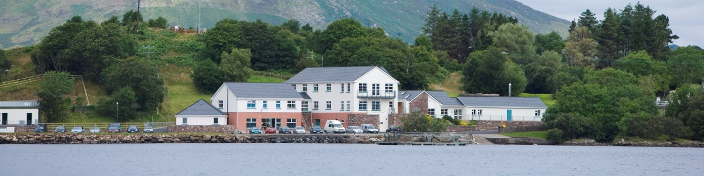
Unlocking the archive
4 year collaborative project, funded under the Marine Research Programme by the Irish Government (Grant-Aid Agreement No. PBA/FS/16/03)

Slide 3
Project Objectives
Establish Ireland’s first biochronology repository
Create digital database of multidecadal growth information
Provide infrastructure to support new research opportunities
Develop capacity in biological and environmental time series analysis
Develop methods for analysing the composition of scales and otoliths
Investigate responses of migratory fish to environmental change

Slide 4
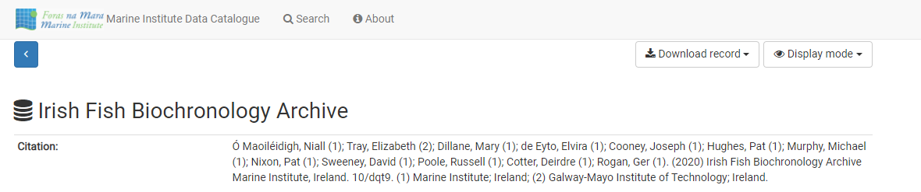
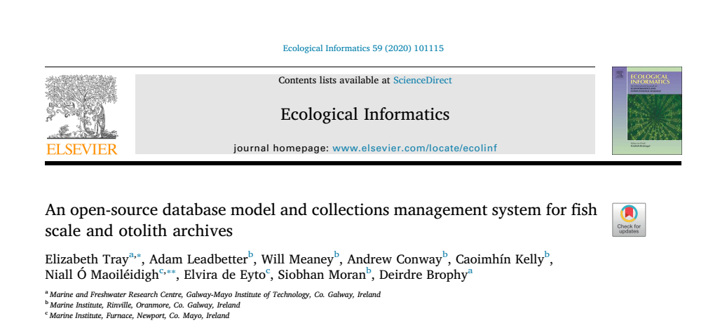
The IFBA Dataset
The Collections Management System

Slide 5

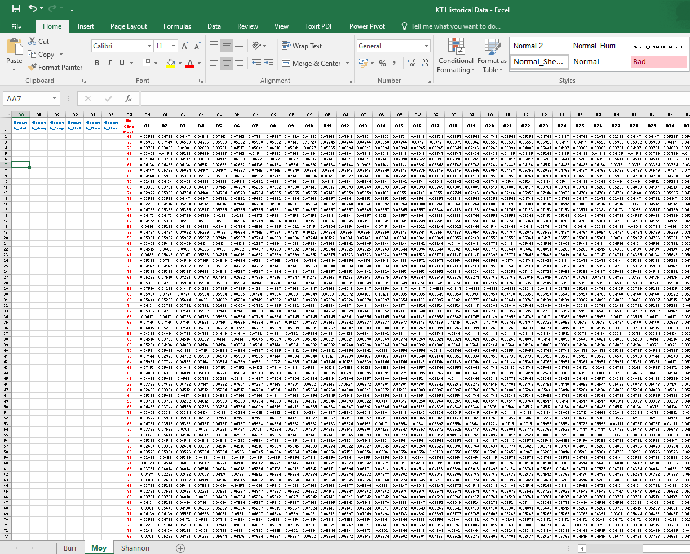
The collections management system
Tray, E., Leadbetter, A., Meaney, W., Conway, A., Kelly, C., Maoiléidigh, N.Ó., de Eyto, E., Moran, S., Brophy, D., 2020. An open-source database model and collections management system for fish scale and otolith archives. Ecological Informatics, 101115.

Slide 6
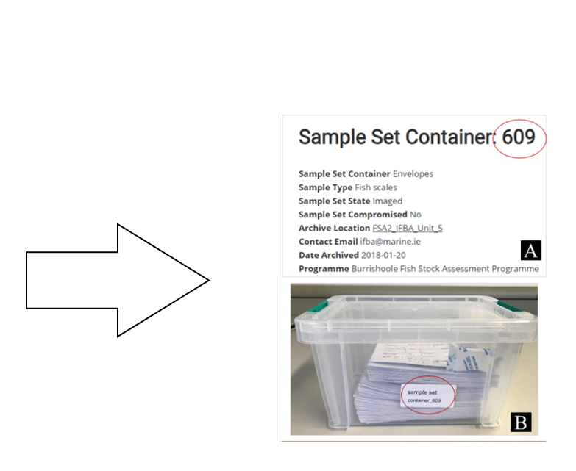
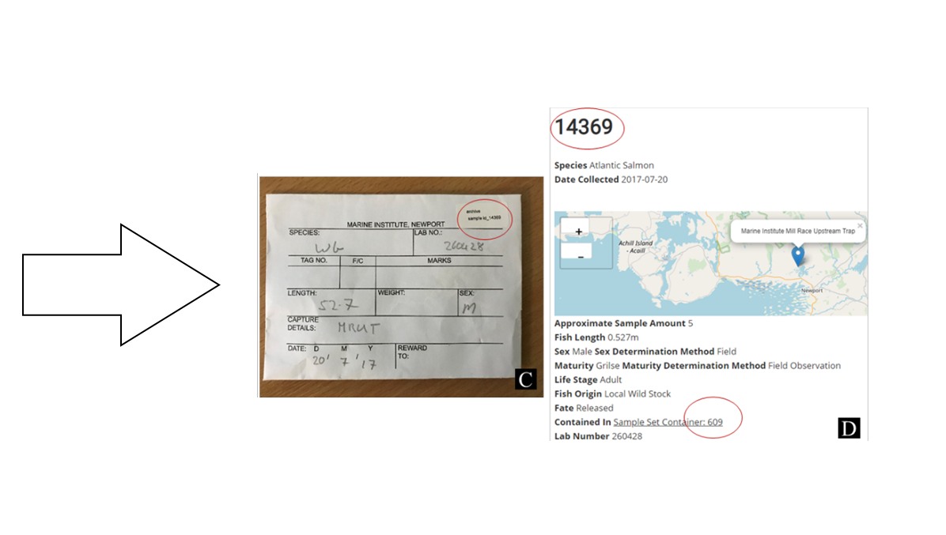
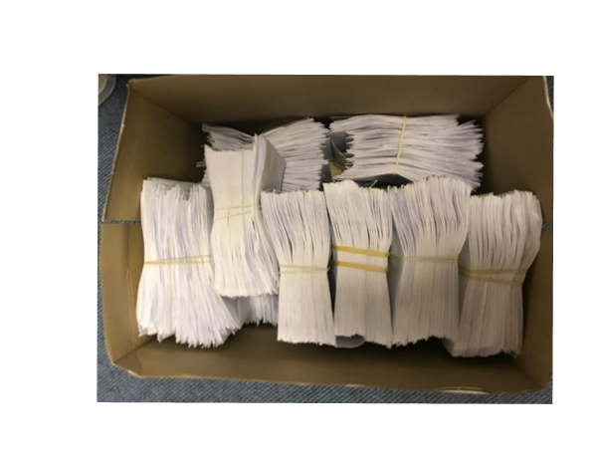
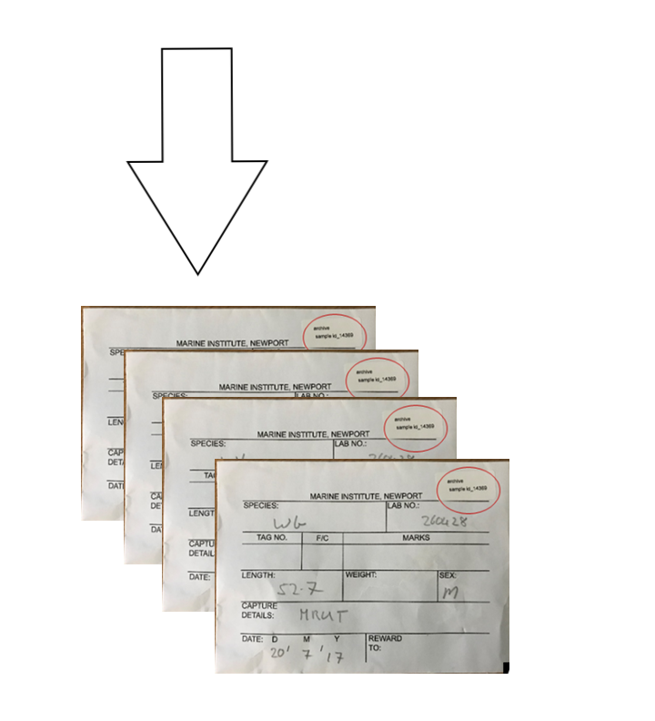

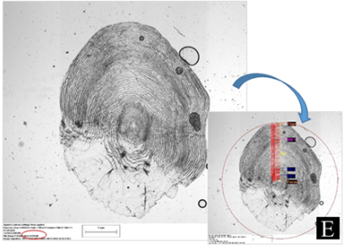


The scale collection
Representative sample
“How will I get 110,00 samples into the repository/catalogue?” (Elizabeth Tray, 2018)
Growth time series
Fully catalogued
sample set container
Genetics
Tagging information
Scale composition
Etc.

Slide 7
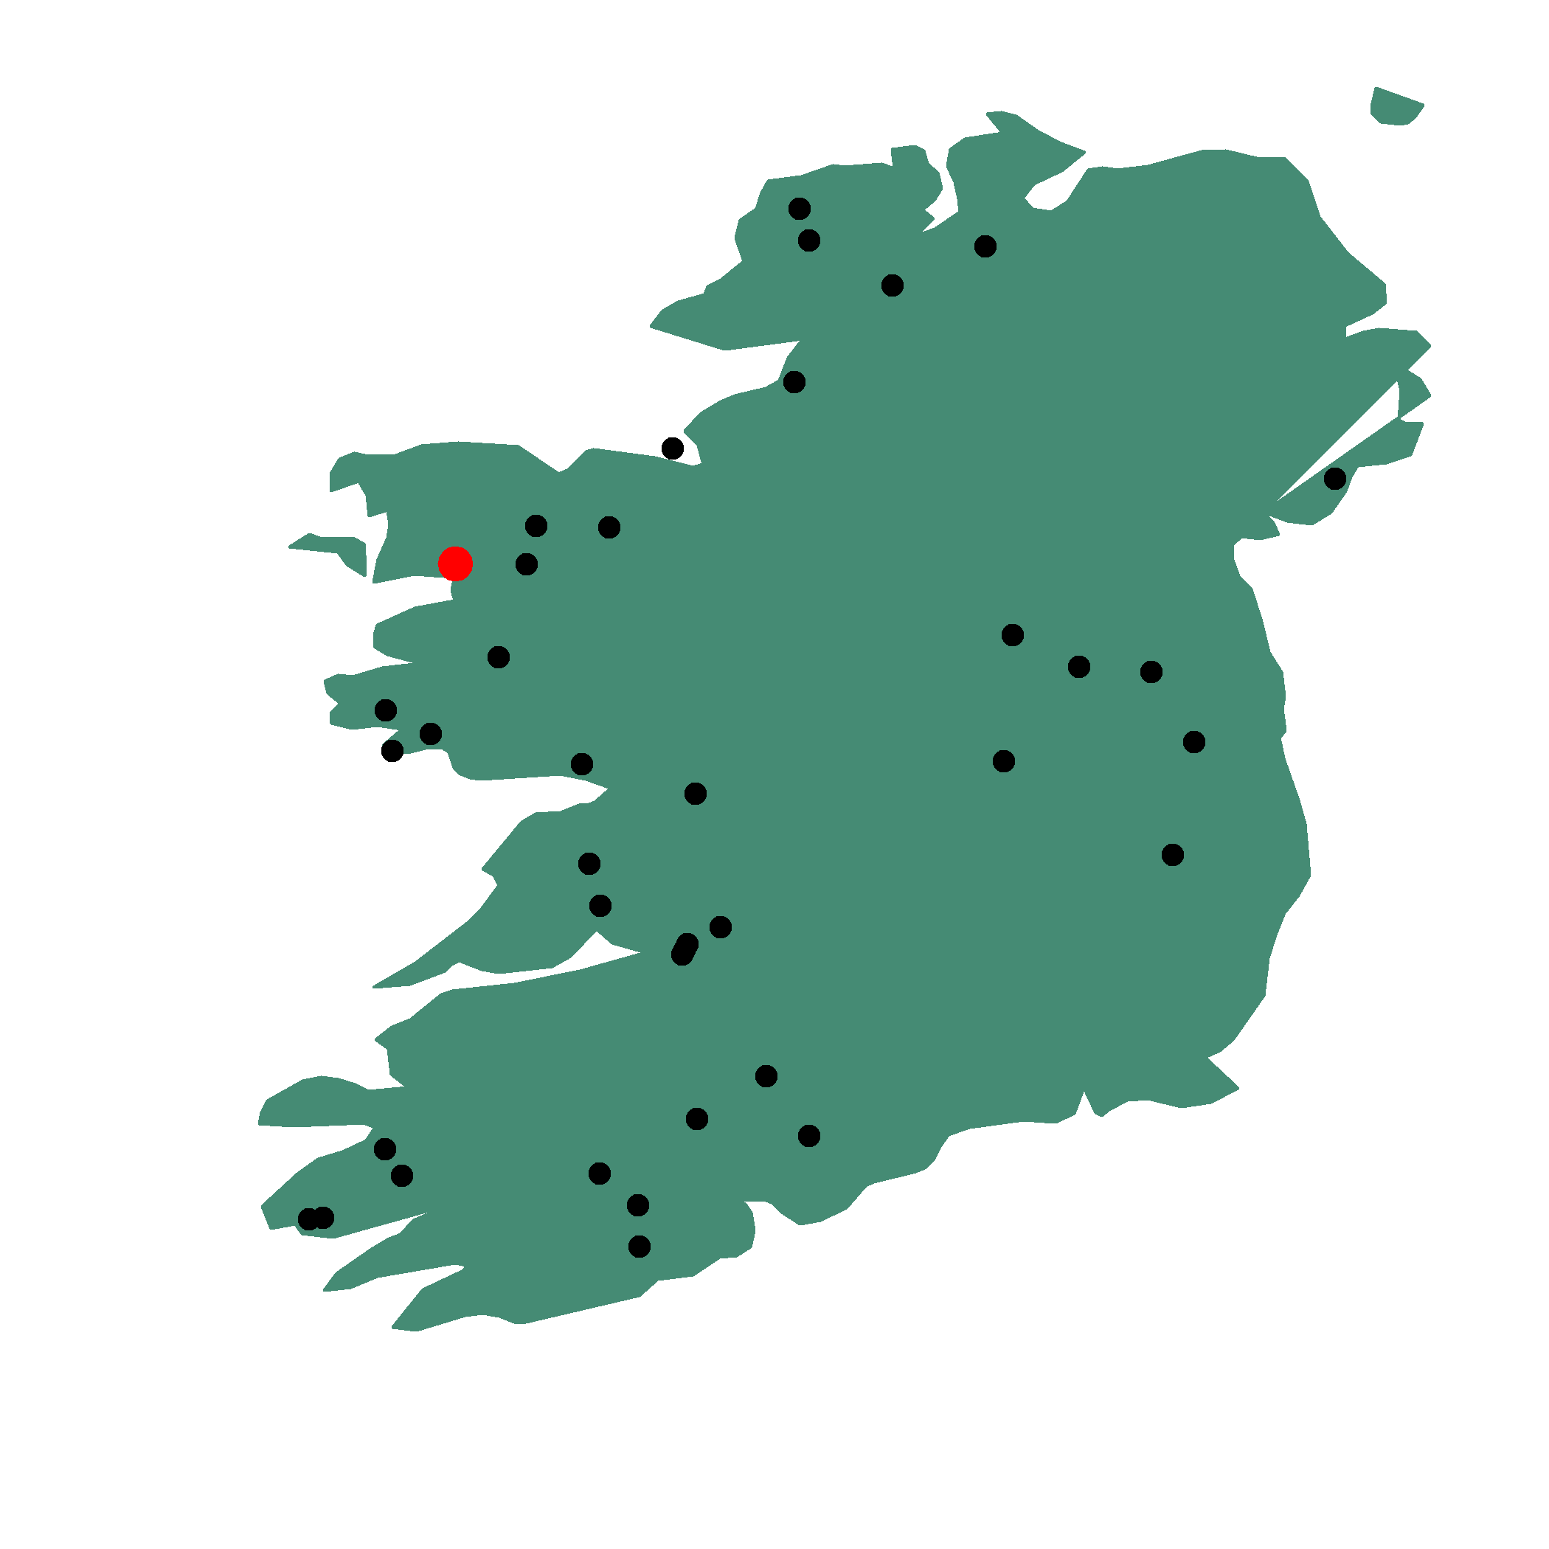
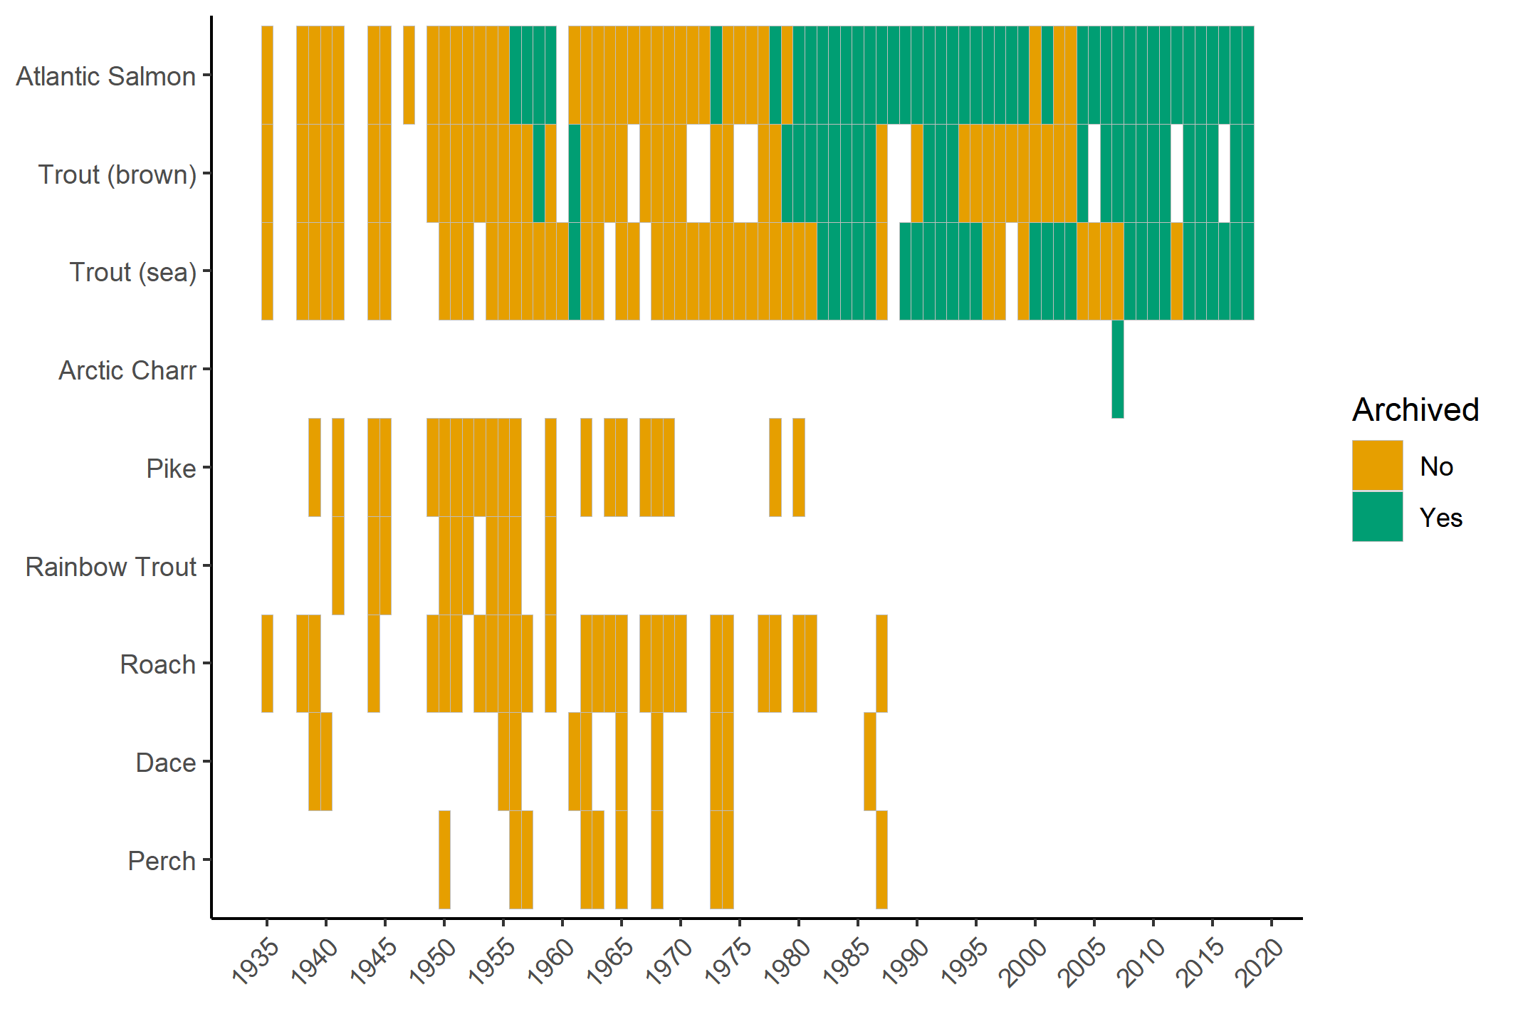
The collection: taxonomic and geographical coverage

Slide 8
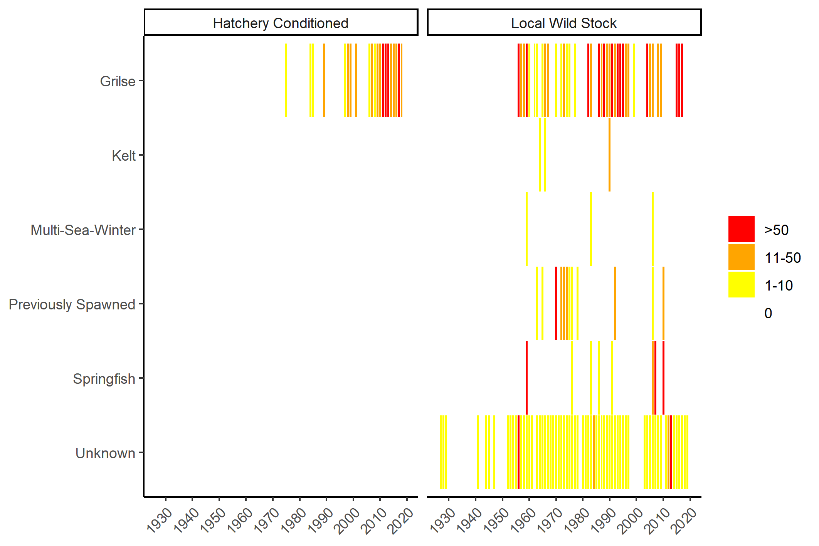
Catalogued individuals: Atlantic salmon

Slide 9
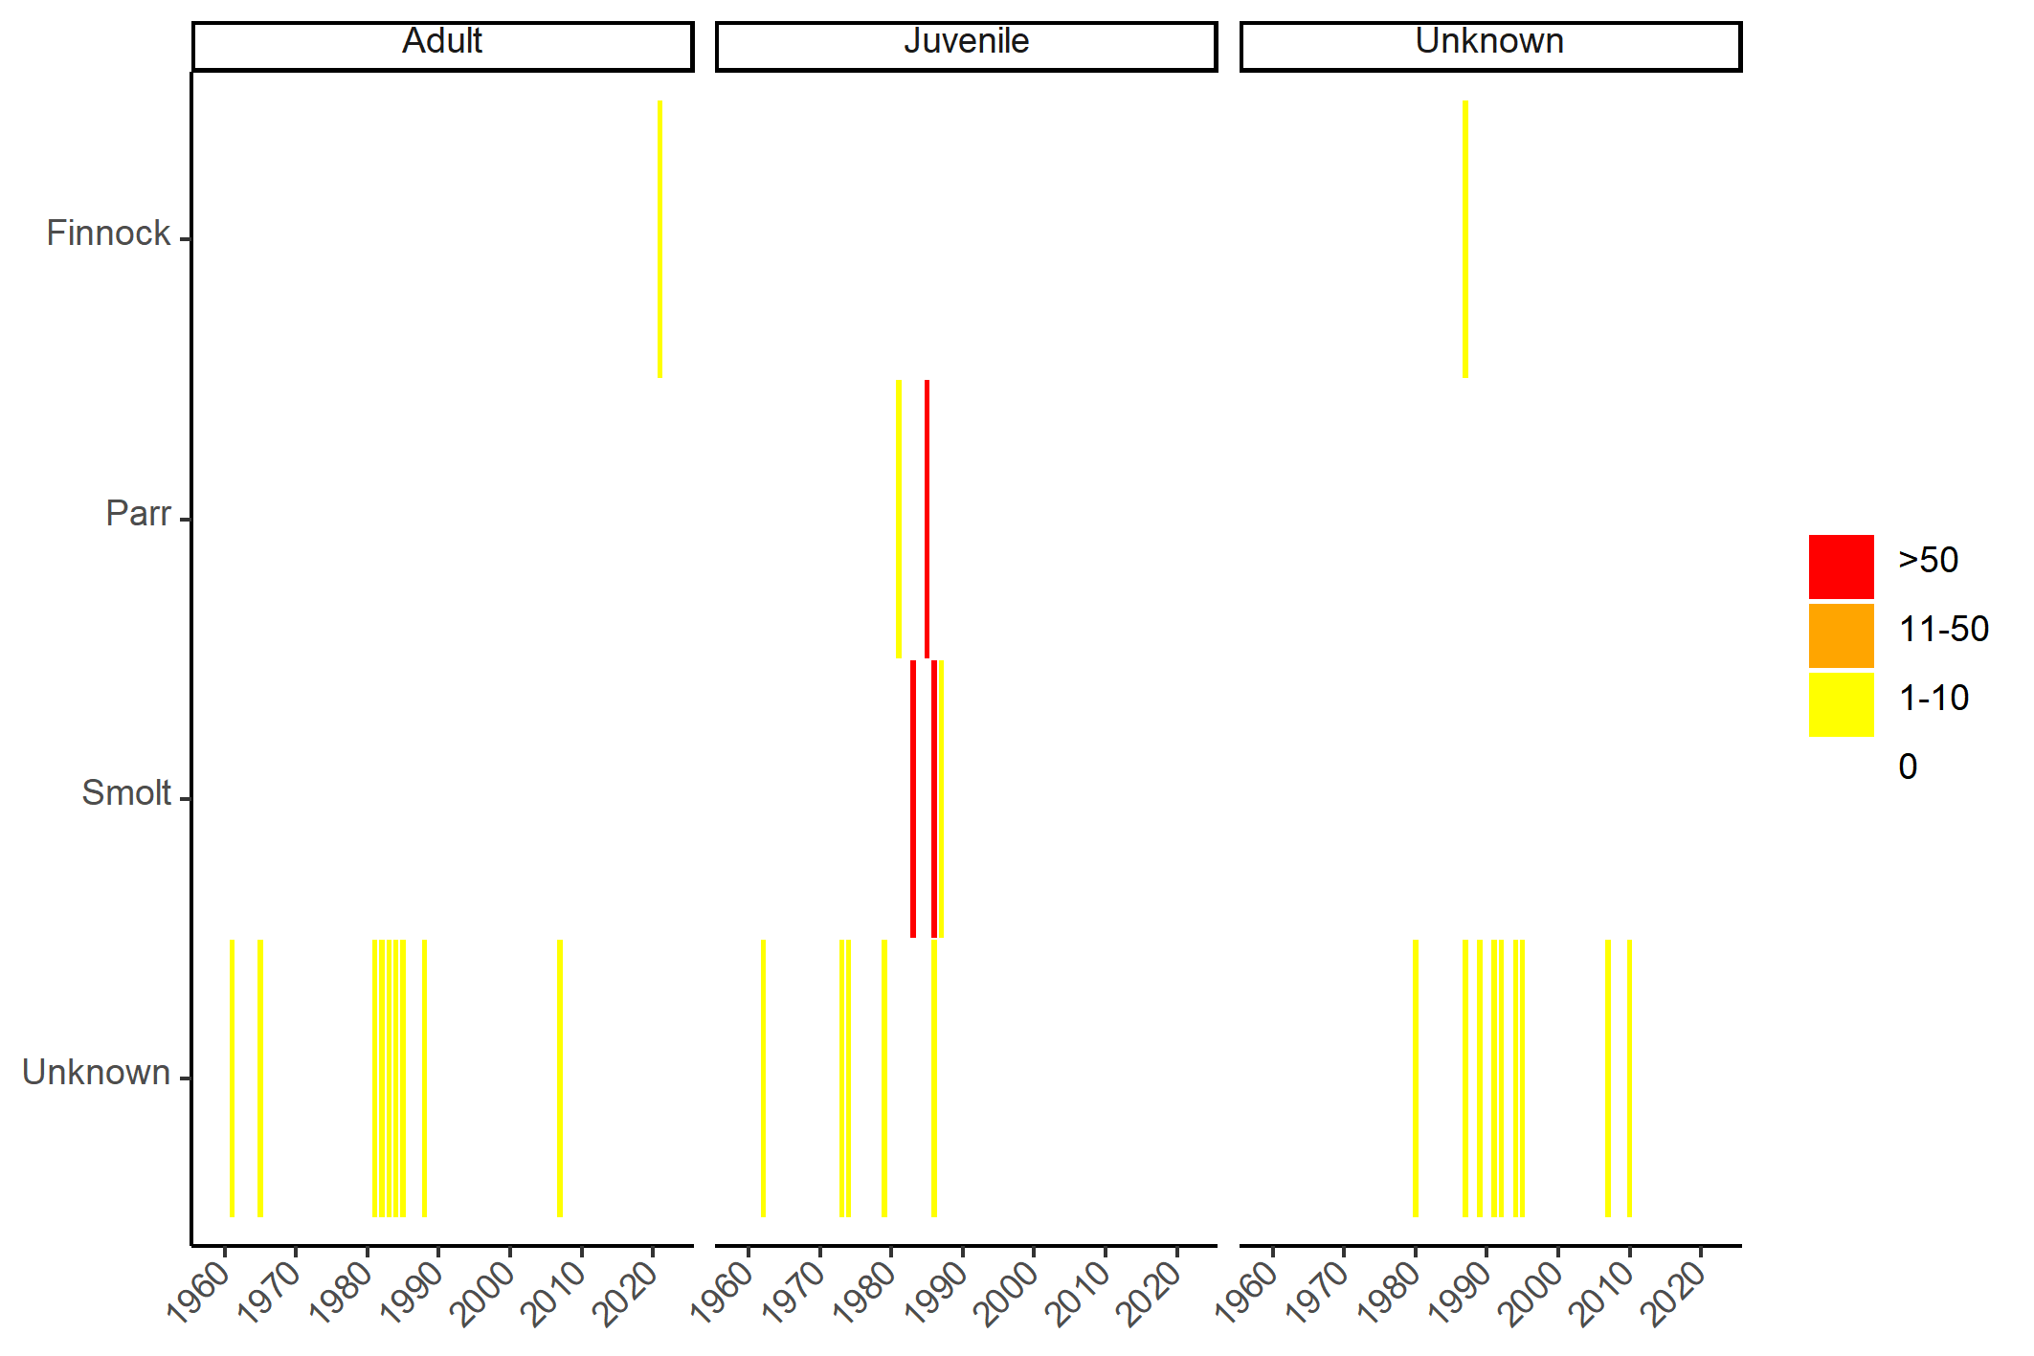
Catalogued individuals: Trout

Slide 10
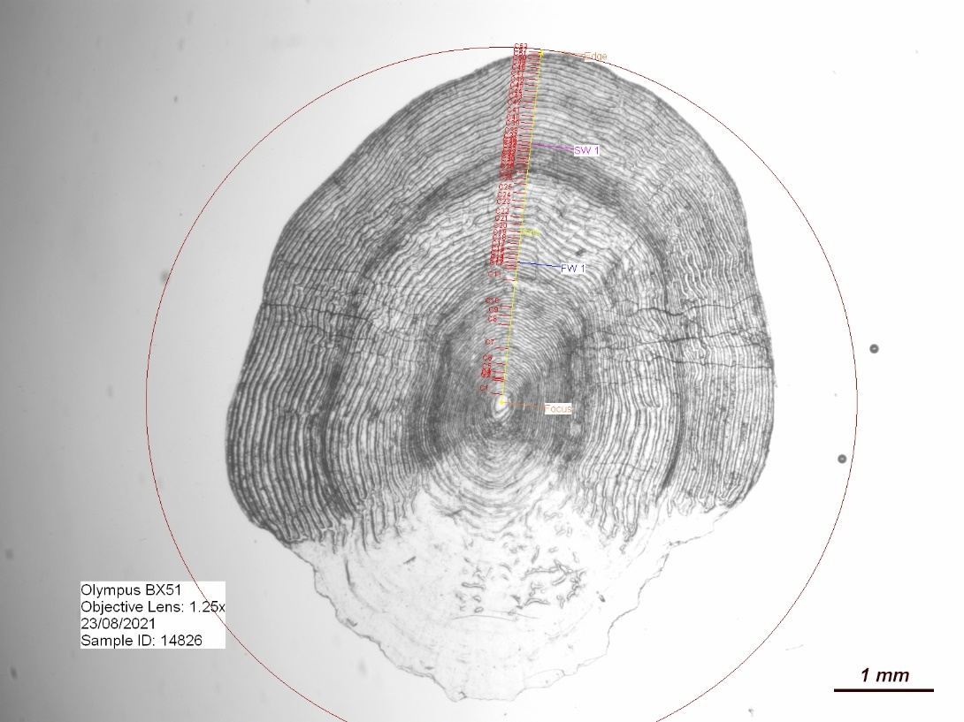
Growth data
 | Atlantic Salmon | Trout
Scales | 402 | 1
 | 1403 | 404
Circuli
Linked to IFBA
Not yet linked to IFBA

Slide 11
Moving forward
Resources needed to support maintenance and expansion of IFBA
A “gate-keeper” with overall responsibility (not a full-time job)
Data management support
CSV upload tool would greatly enhance efficiency (2 months person power needed)
Input of historical samples can be supported by bursars and research projects
Potential to expand IFBA to include other scale and otolith collections
Link with similar collections internationally (more later)
Stimulate new research activities supported by IFBA
Huge value for long-term ecological monitoring and climate change research

Slide 12

Acknowledgements
This study was funded through a Grant-Aid Agreement No. PBA/FS/16/03 (unlocking the archive: using scale and otolith chronologies to resolve climate impacts) under the Marine Research Programme by the Irish Government.

